Slide 1


Department of Information Science & Engineering
Dept. of ISE
CLOUD COMPUTING MODULE-2
Dr.Gulab Singh Chauhan
Professor Dept of ISE

Slide 2
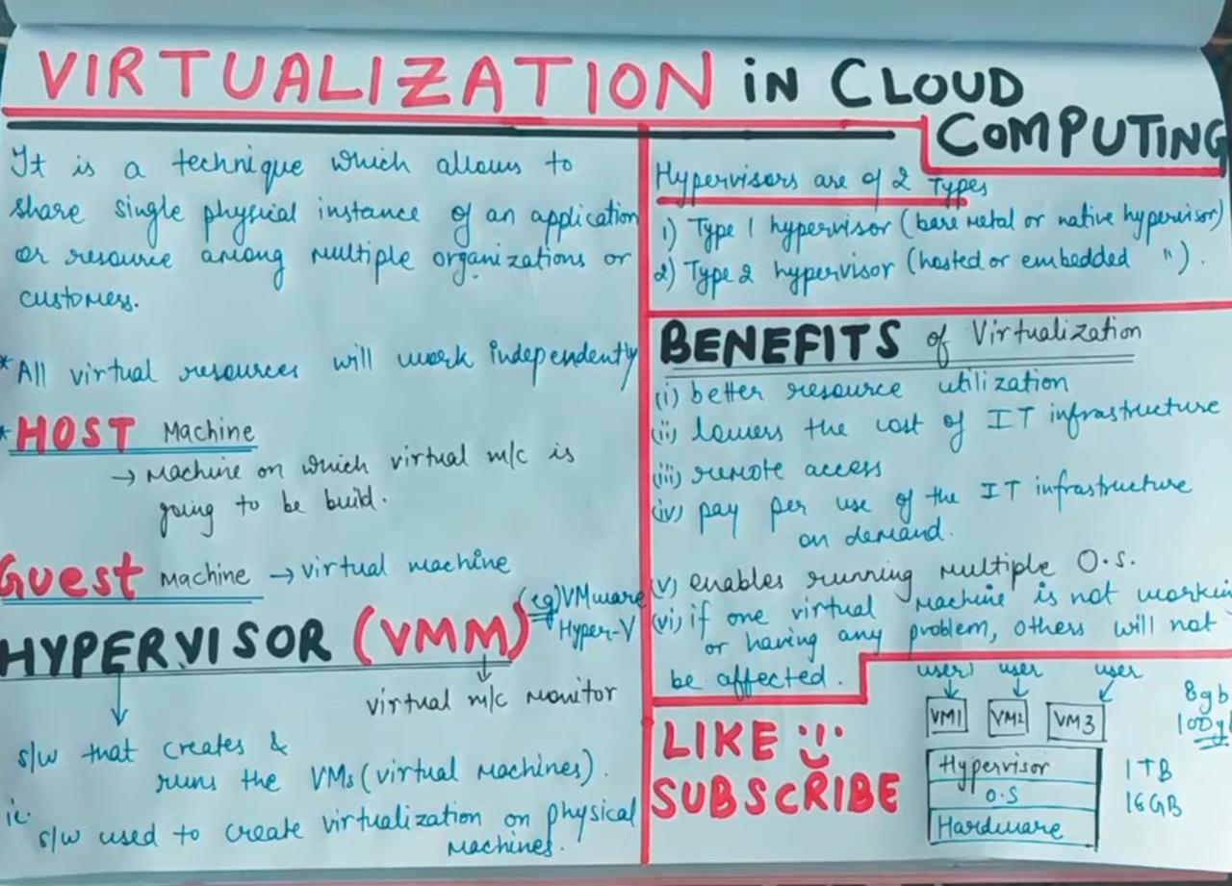
Dept. of ISE

Slide 3
VIRTUALIZATION
Virtualization allows the creation of multiple virtual instances of something such as a server, desktop, storage device, operating system, etc. Thus, Virtualization is a technique that allows us to share a single physical instance of a resource or an application among multiple customers and an organization.
Dept. of ISE

Slide 4
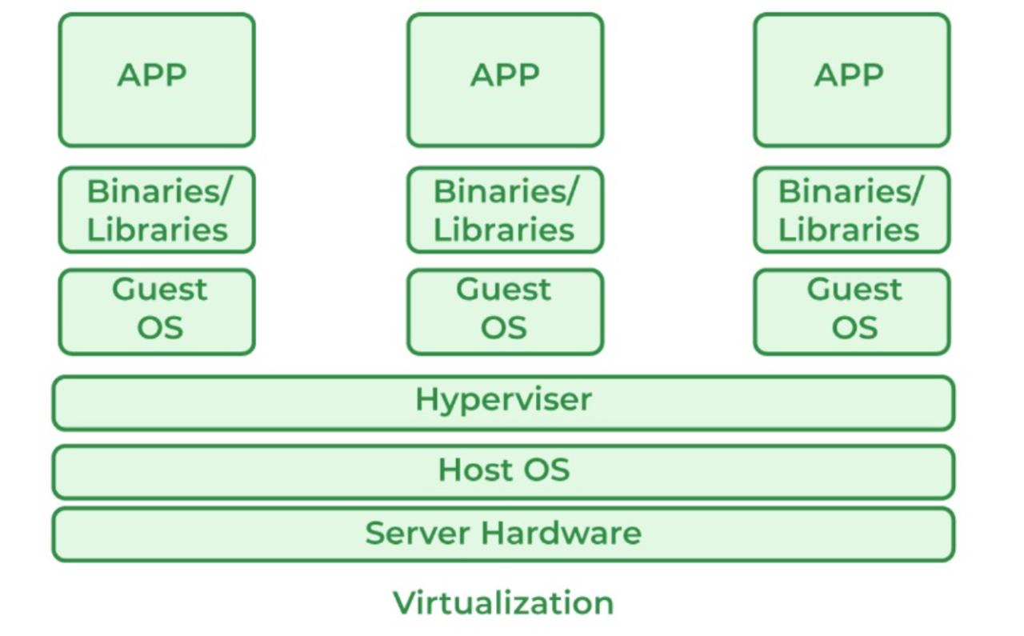
Dept. of ISE

Slide 5
VIRTUALIZATION is a technology that creates virtual representations of various computing resources, allowing more efficient utilization of physical hardware.
Host Machine: The machine on which the VIRTUAL MACHINES is going to be created is known as Host Machine.
Guest Machine: The virtual machines that are created on the Host Machine are called Guest Machines.
Dept. of ISE

Slide 6
Characterstics of Virtualization
Isolation
Encapsulation
Hardware Independence
Resource Sharing
Snapshot and Cloning
Dynamic Resource Allocation:
High Availability and Fault Tolerance
Scalability
Dept. of ISE

Slide 7
Pros of Virtualization
Utilization of Hardware Efficiently: With the help of Virtualization Hardware is Efficiently used by user as well as Cloud Service Provider. In this the need of Physical Hardware System for the User is decreases and this results in less costly.
High Availability:One of the main benefit of Virtualization is that it provides advance features which allow virtual instances to be available all the times.
Dept. of ISE

Slide 8
Pros of Virtualization
Disaster Recovery is efficient and easy: With the help of virtualization data recovery, Backup, Duplication becomes very easy. In traditional method , if somehow due to some disaster if Server system Damaged then the surity of Data Recovery is very less. But with the tools of Virtualization real time data backup recovery and mirroring become easy task and provide surety of zero percent data loss.
Virtualization saves Energy :Virtualization will help to save Energy because while moving from physical Servers to Virtual Server’s, the number of Server’s decreases due to this monthly power and cooling cost decreases which will Save Money as well.
Dept. of ISE

Slide 9
Pros of Virtualization
Quick and Easy Set up:With the help of virtualization the entire process is done in very less time which results in productive setup.
Cloud Migration becomes easy:It is more cost-effective to shift to cloud services because all the data that is present in their server’s can be easily migrated into the cloud server and save something from maintenance charge, power consumption, cooling cost, cost to Server Maintenance Engineer etc.
Resource Optimization:Virtualization allows efficient utilization of physical hardware by running multiple virtual machines (VMs) on a single physical server.
Dept. of ISE

Slide 10
Cons of Virtualization
High Initial Investment:While virtualization reduces costs in the long run, the initial setup costs for storage and servers can be higher than a traditional setup.
Complexity:Managing virtualized environments can be complex, especially as the number of VMs increases.
Security Risks:Virtualization introduces additional layers, which may pose security risks if not properly configured and monitored.
Dept. of ISE

Slide 11
Cons of Virtualization
Learning New Infrastructure:As Organization shifted from Servers to Cloud. They required skilled staff who can work with cloud easily. Either they hire new IT staff with relevant skill or provide training on that skill which increase the cost of company.
Data can be at Risk :Working on virtual instances on shared resources means that our data is hosted on third party resource which puts our data in vulnerable condition. Any hacker can attack on our data or try to perform unauthorized access. Without Security solution our data is in threaten situation.
Dept. of ISE

Slide 12
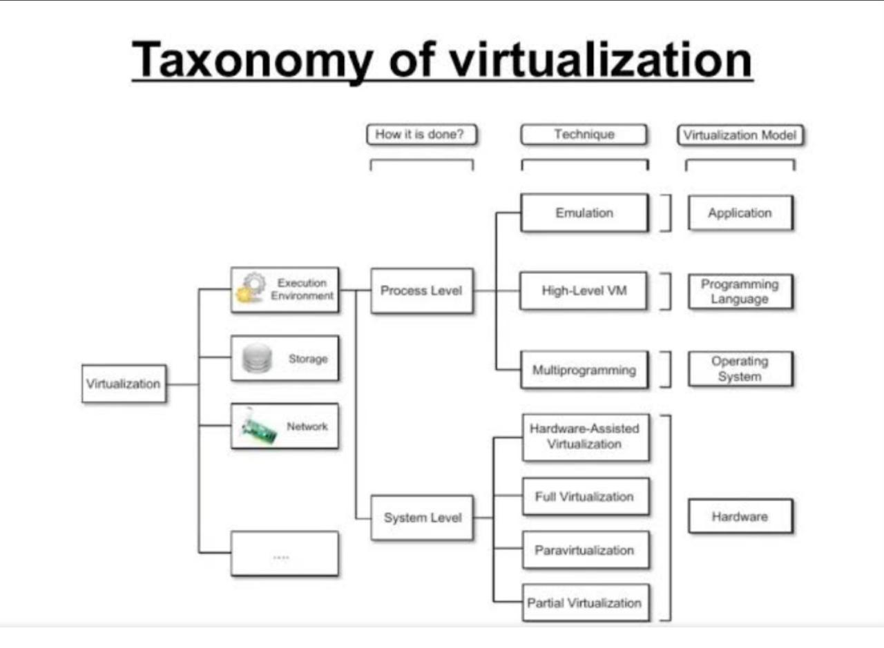
Dept. of ISE

Slide 13
Types of Virtualization in Cloud Computing (Technology examples)
Virtualization manifests in various forms, each serving specific purposes within the cloud environment:
Server Virtualization: Divides a physical server into multiple, isolated virtual servers, optimizing resource use and reducing costs.
Storage Virtualization: Consolidates storage from multiple devices into a single, virtual storage pool, simplifying management.
Network Virtualization: Creates virtual networks that operate independently over a single physical network, enhancing security and efficiency.
Desktop Virtualization: Enables remote access to desktop environments, which are stored on a central server.
Application Virtualization: Allows applications to run on any device regardless of the underlying operating system.
Data Virtualization: Integrates data from various sources into a single, logical view, facilitating access and analysis.
Dept. of ISE

Slide 14
Execution virtualization refers to techniques that create an emulated execution environment, separate from the one hosting the virtualization layer. This allows programs, including operating systems and applications, to run in a virtualized environment. Here are some key points:
Types of Execution Virtualization:
Full Virtualization: Emulates the entire hardware environment, allowing unmodified operating systems and applications to run as if they were on physical hardware.
Paravirtualization: Requires modifications to the guest operating system to optimize performance by allowing direct communication with the hypervisor.
Hardware-Assisted Virtualization: Uses hardware features to improve the efficiency of virtualization, reducing the overhead associated with emulation¹.
Dept. of ISE

Slide 15
Levels of Virtualization:
System Level: Virtualizes the entire operating system, allowing multiple OS instances to run on a single physical machine.
Process Level: Virtualizes individual processes, providing isolated execution environments for applications.
Dept. of ISE

Slide 16

Dept. of ISE

